Slide 1
Lecture 13
Topics
  Latches
  Flip Flops
  Algorithmic State Machines

Slide 2
Latches

Slide 3
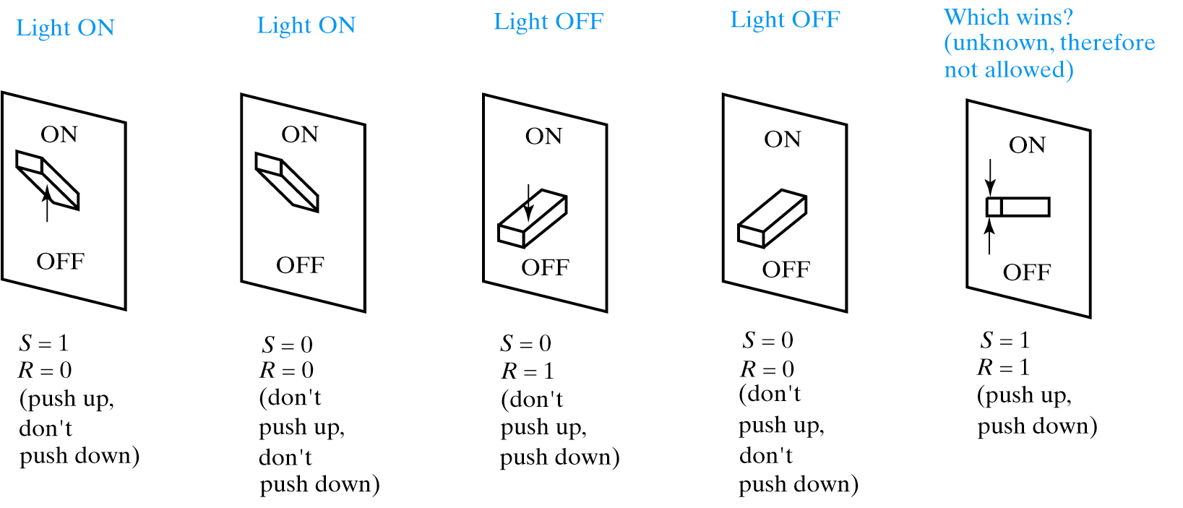
Possible States for Light Switch

Slide 4
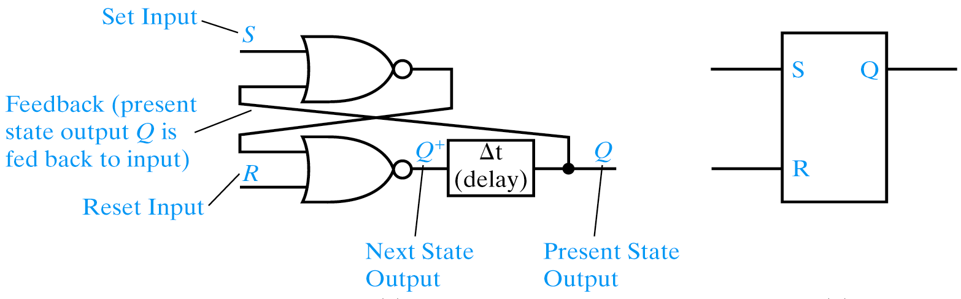
S-R Latch
S R Q⁺
0 0 Q
0 1 0
1 0 1
1 1 0
S-R latch is reset dominant
Different ways to name/nomenclature for current/next state. Text uses Q+ for next.

Slide 5
Alternative Nomenclature for latches
Present State Next State
Output Symbol Output Symbol
Q Q
Q Q(t+1)
Qt Q(t+1)
Qn Q(n+1)
Q0 Q
Y Y⁺
y Y

Slide 6
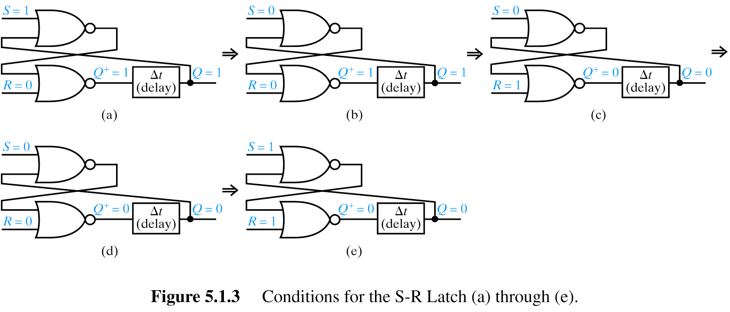
S-R Latch States
S-R latch is
reset dominant

Slide 7
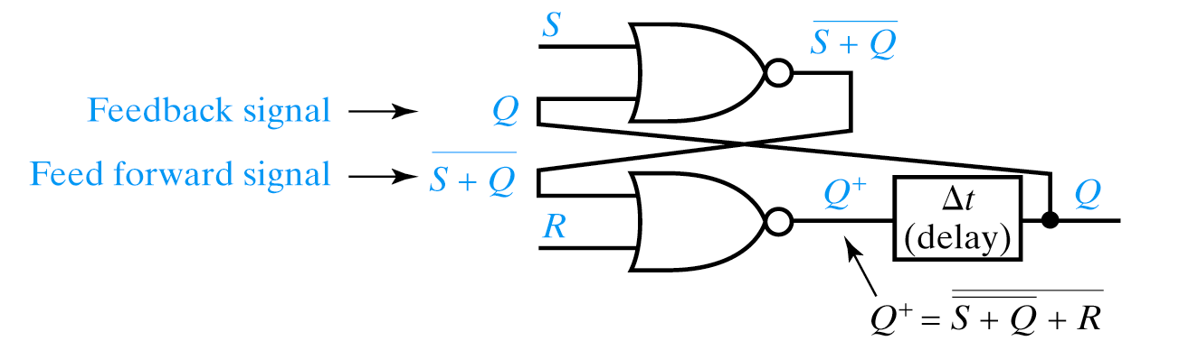
Characteristic Equations

Slide 8
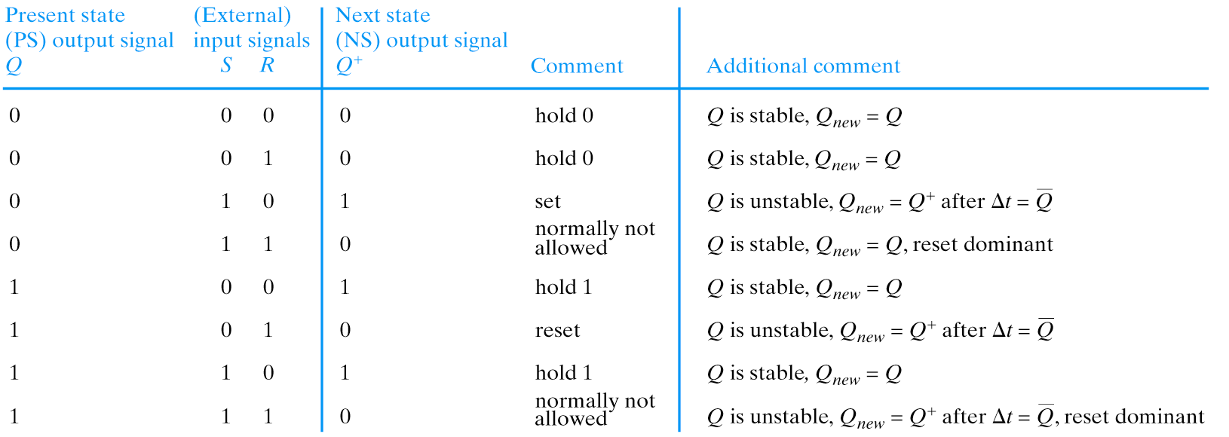
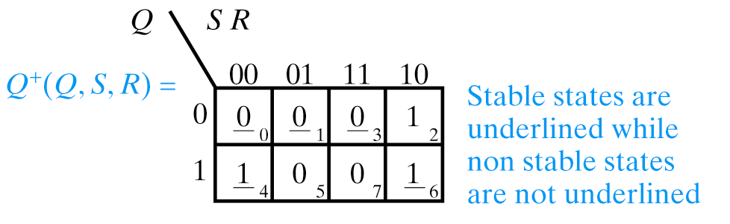
Present State/Next State Table
(PS/NS)

Slide 9
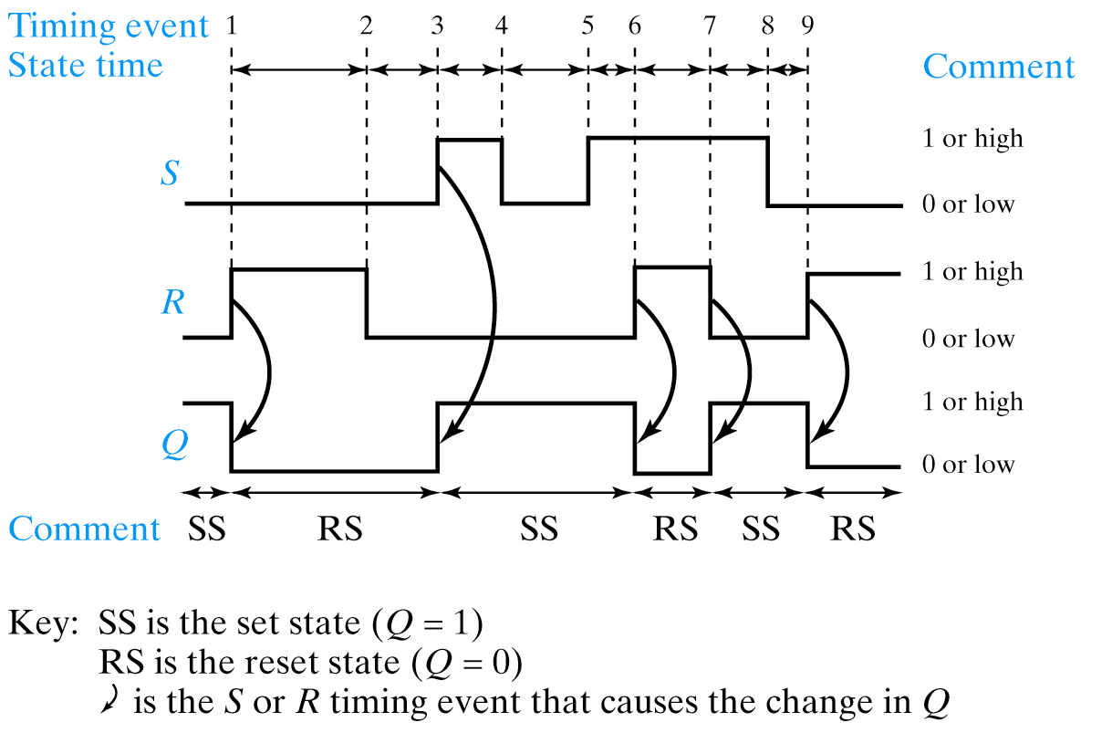
Timing Diagram

Slide 10
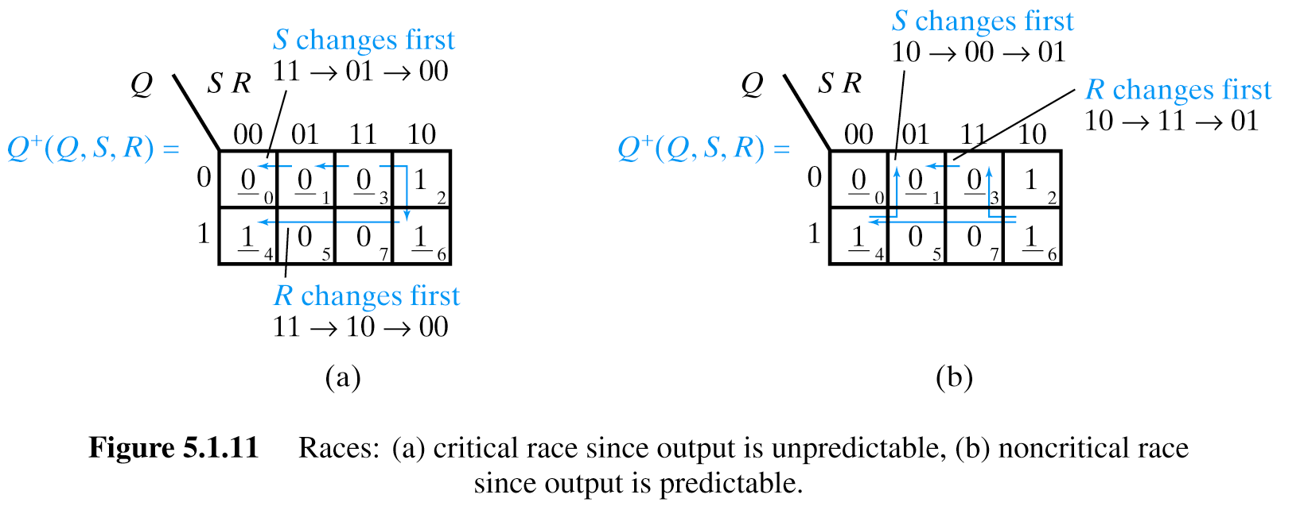
Races
Critical Race
Non-critical Race

Slide 11
Races
Just as we used K-maps to not only reduce Boolean equations but to detect hazards, we can use K-maps to analyze anomalous latch behavior as well.
Race is when two or more inputs change simultaneously.
May or may not be a critical race.
Depends upon the behavior of the circuit.

Slide 12
Races
Critical race:
We start in State represented by minterm m3. (stable state) Q is 0, SR are 11s.
Both S and R are transitioning to 0.
Notice we take different paths through the K-map depending upon whether R or S transitions first.
If S transitions first, we transition to state m0 where Q+ remains Q (no transitions on output).
However, if R transitions first, we attempt to set the latch, resulting in Q+ = 1.
Then, when S transitions we go to state m4.
Not only do we end up in different states, but we have different values on the Q output – all depending upon minor differences in relative timing between transitions on S/R.
This is a critical race.

Slide 13
Races
Non-critical race:
Start in state m6 (stable) with SR 10. Both S and R are going to change.
If S changes first, we go to state m4 (a stable state) with no transition on output.
Then when R changes we transition to state m1, also a stable state, and with an output of 0.
If R changes first, we transition to state m3, a stable state with a transition to 0 on output.
When S subsequently changes we transition to m1, another stable state where Q remains 0.
Non-critical race – OK and correct behavior regardless of which signal transitions first.

Slide 14
Metastable State
An often overlooked condition in which the output can remain in an illegal (even oscillating) state for an indeterminant period of time.
Metastability can be caused by a runt pulse (a positive or negative pulse which never achieves either a value of a 1 or 0). This can occur when two inputs to a gate change near simultaneously (see hazards earlier).
Metastability can also when two inputs to a latch change near simultaneously.
Condition also arises when synchronizing with external events (e.g. asynchronous inputs to synchronous finite state machines).

Slide 15
State Machines

Slide 16
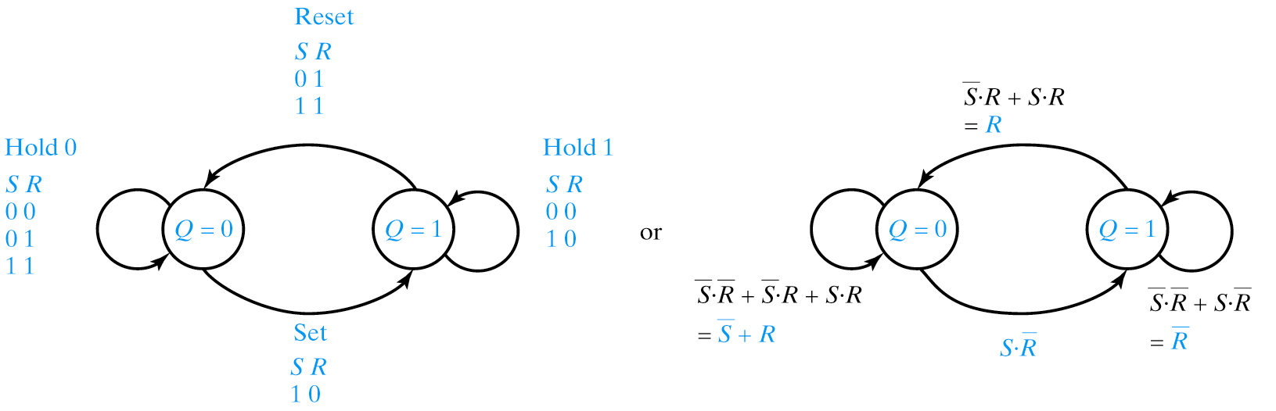
State Diagrams
S R Q Q⁺
0 0 0 0
0 0 1 1
0 1 0 0
0 1 1 0
1 0 0 1
1 0 1 1
1 1 0 0
1 1 1 0
S R Q⁺
0 0 Q
0 1 0
1 0 1
1 1 0

Slide 17
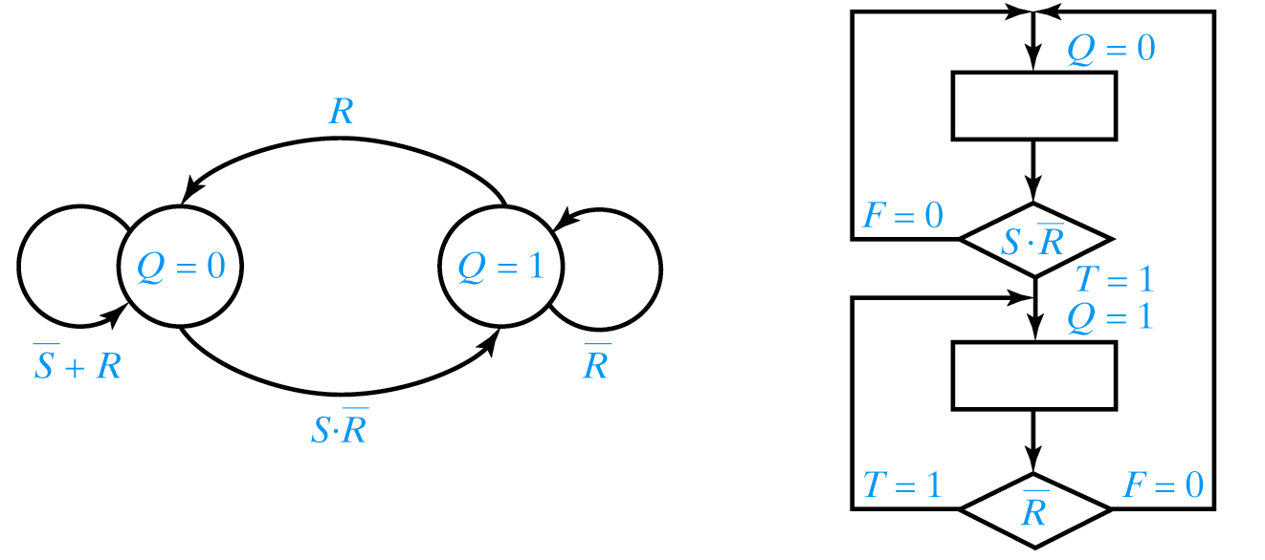
Algorithmic State Machines (ASM)

Slide 18
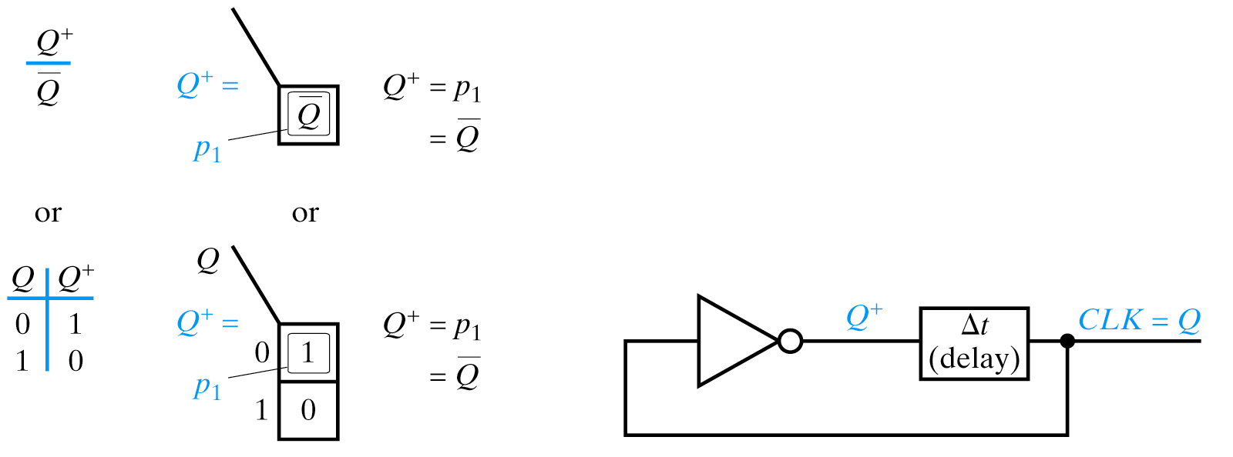
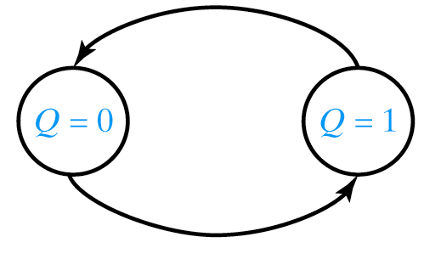
Clock (Oscillator) Circuit
PS/NS Table
K-map
State Diagram
Delay Model

Slide 19
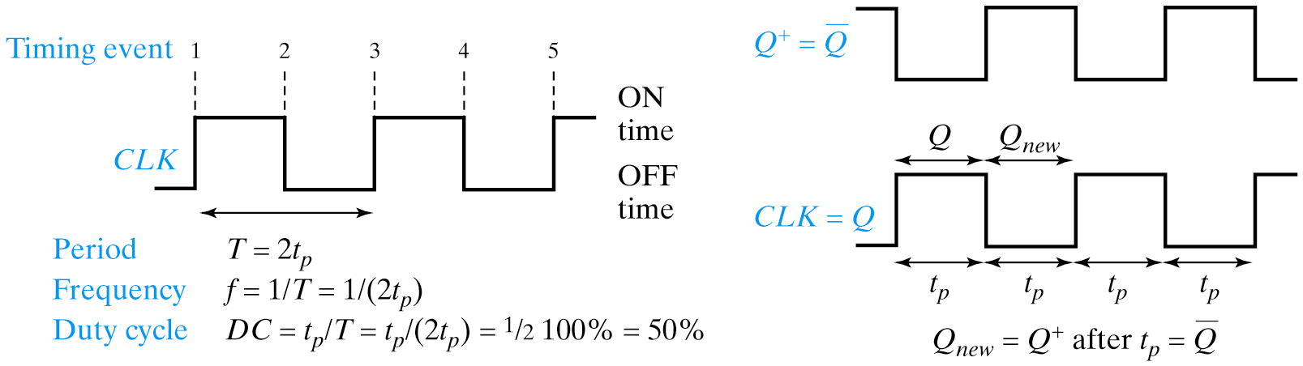
Clock Waveforms
Delay
  Buffers
  Additional (maintain odd number) inverters
  RC circuit
  Crystal Oscillator

Slide 20
Gated Sequential Circuits
Addition of control input
  Gated Latch (Level Activated)
  Edge-Triggered Flip Flop
  Pulse Triggered Flip Flop

Slide 21
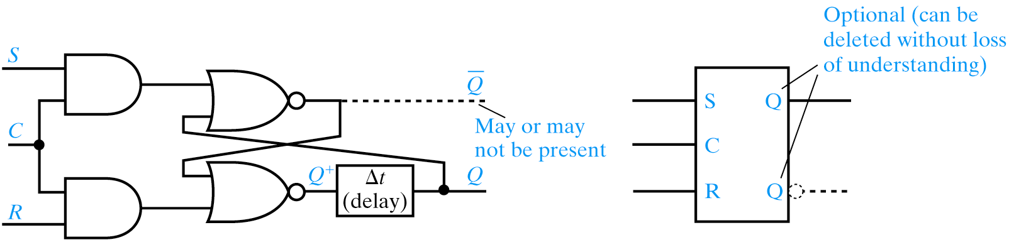
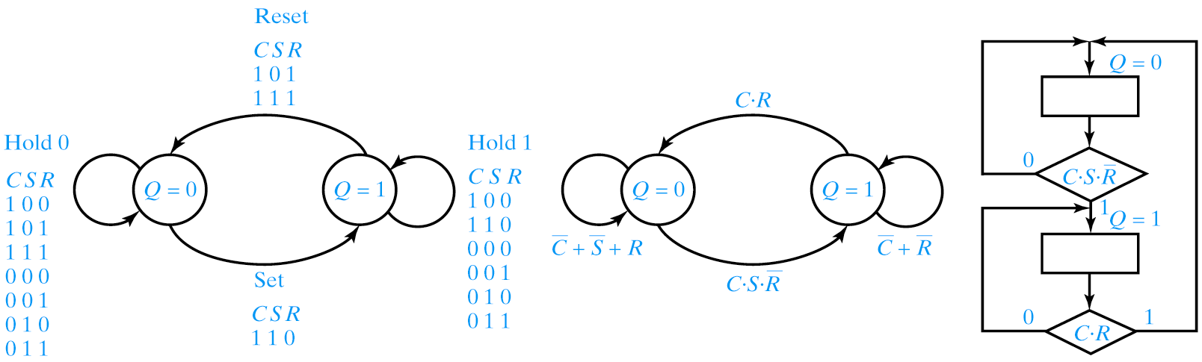
Gated SR Latch

Slide 22
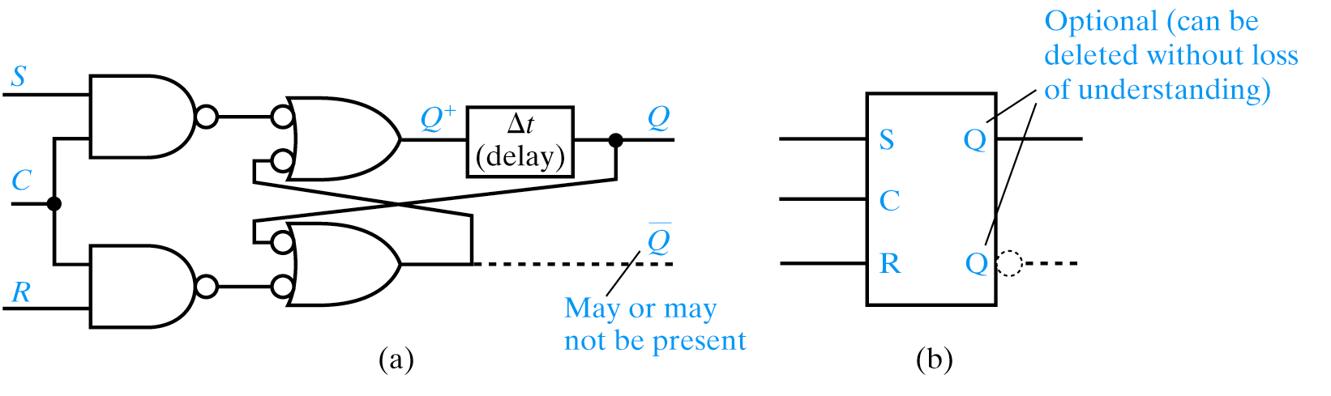
Gated SR Latch Using NANDs

Slide 23
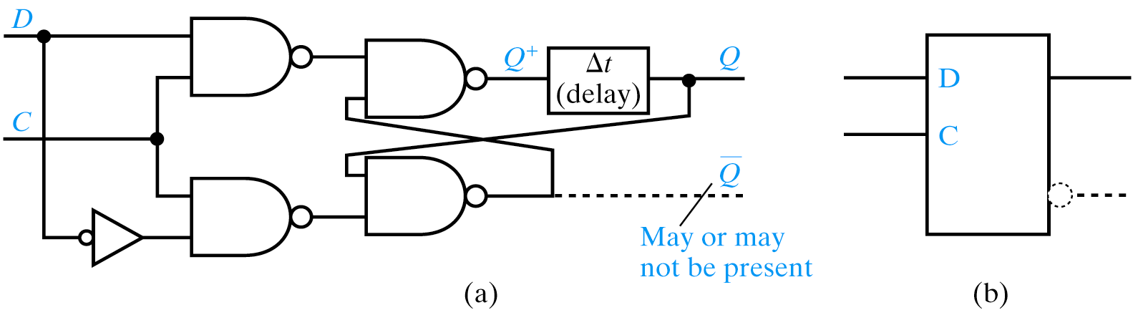
Gated D Latch
D Q⁺
0 0
1 1
D Latch is Hazard Free (product terms chain-linked)

Slide 24
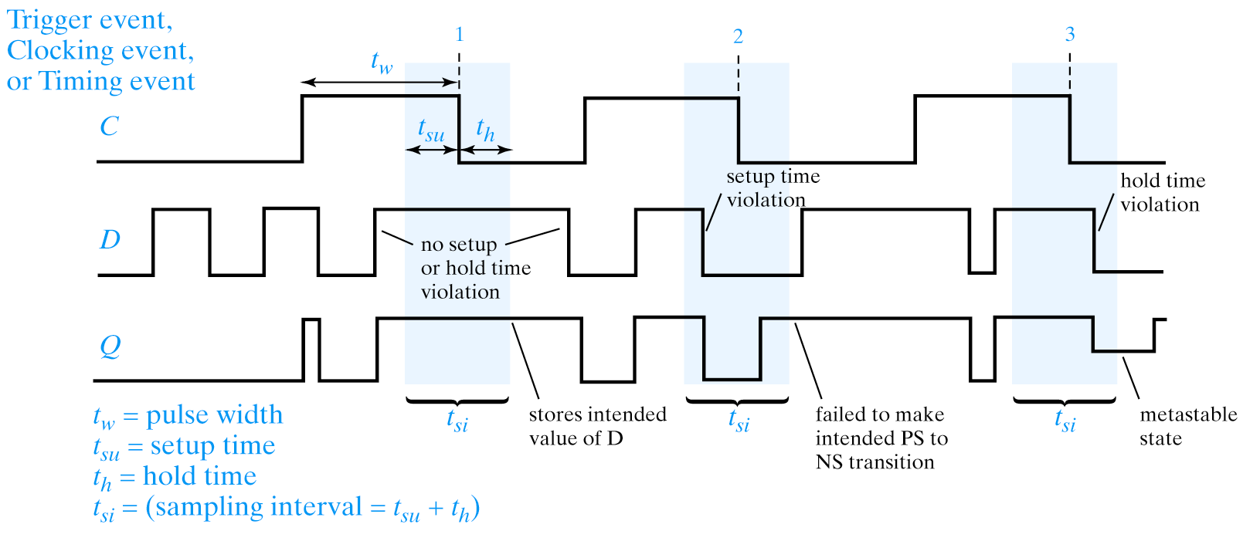
Gated D Latch Timing

Slide 25
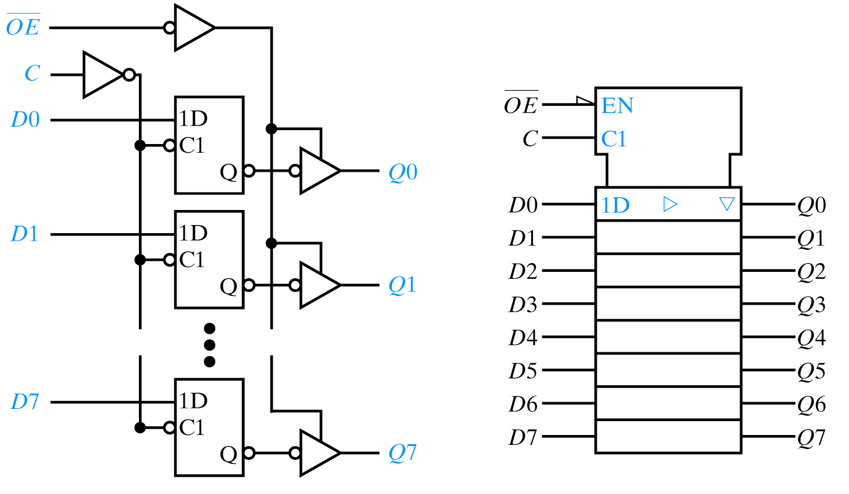
Use as Storage Elements

Slide 26
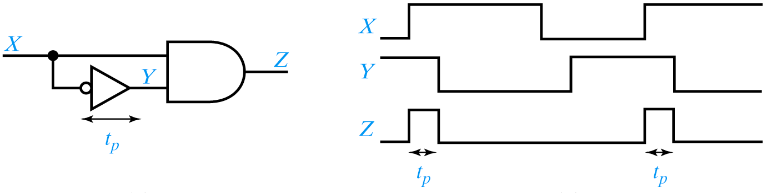
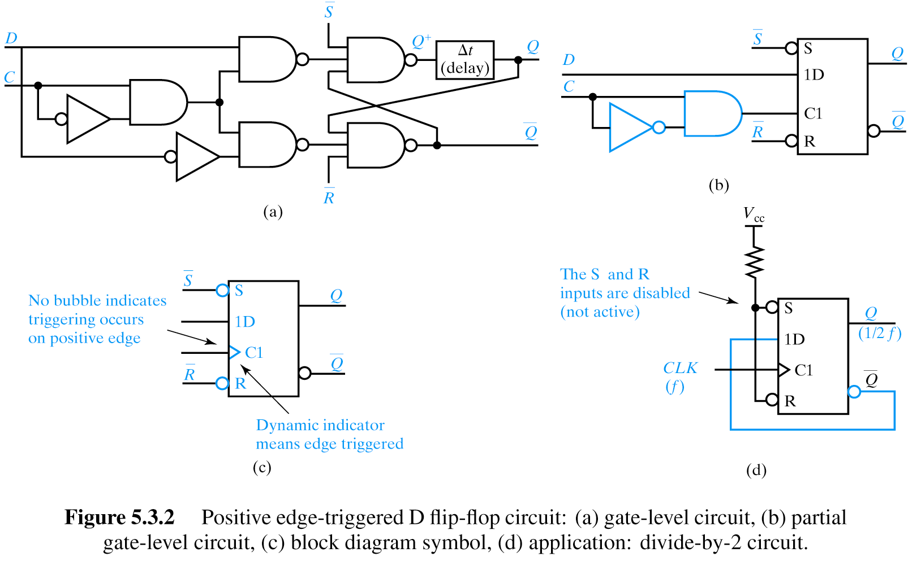
Flip Flop Circuits
Pulse Narrowing Circuit
Explain pulse-narrowing circuit. Attach as front end to D flip flop’s C input.

Slide 27
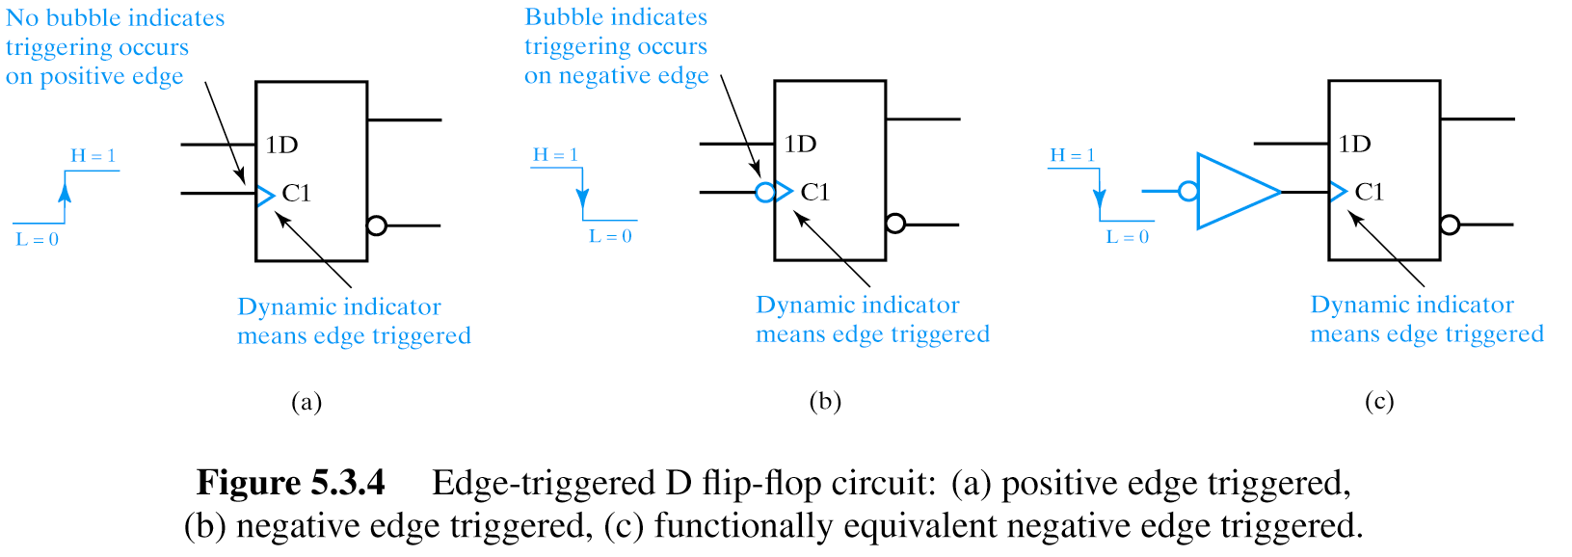
Edge-Triggered D Flip Flop

Slide 28
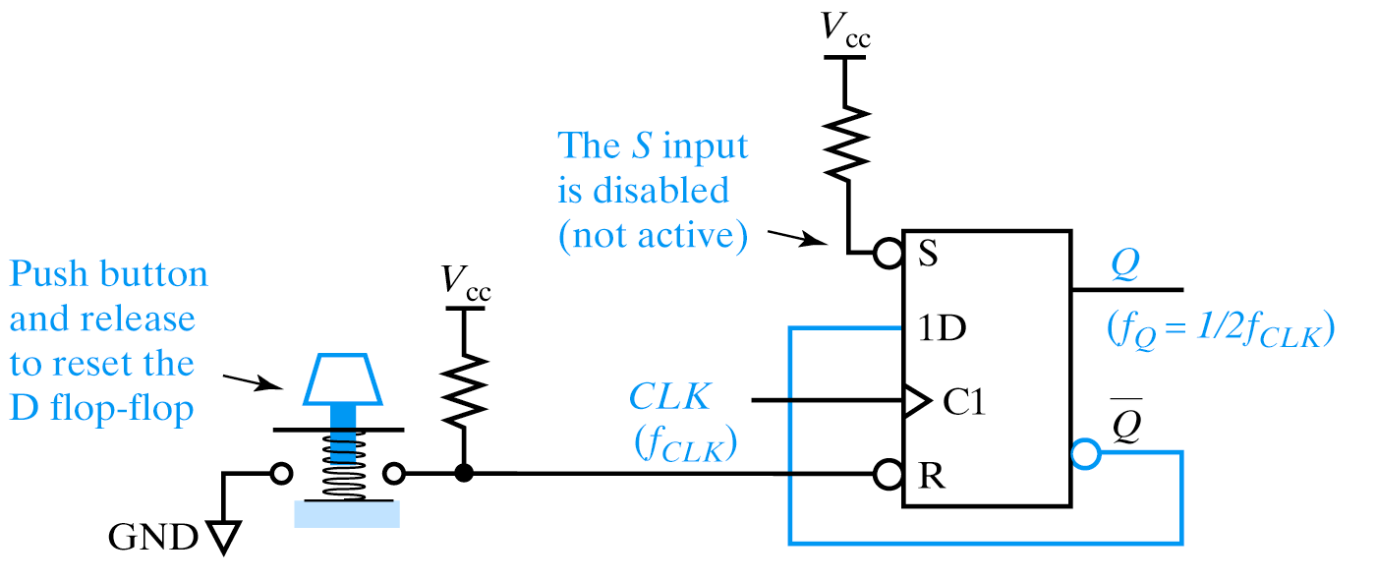
Manual Reset of D Flip Flop

Slide 29
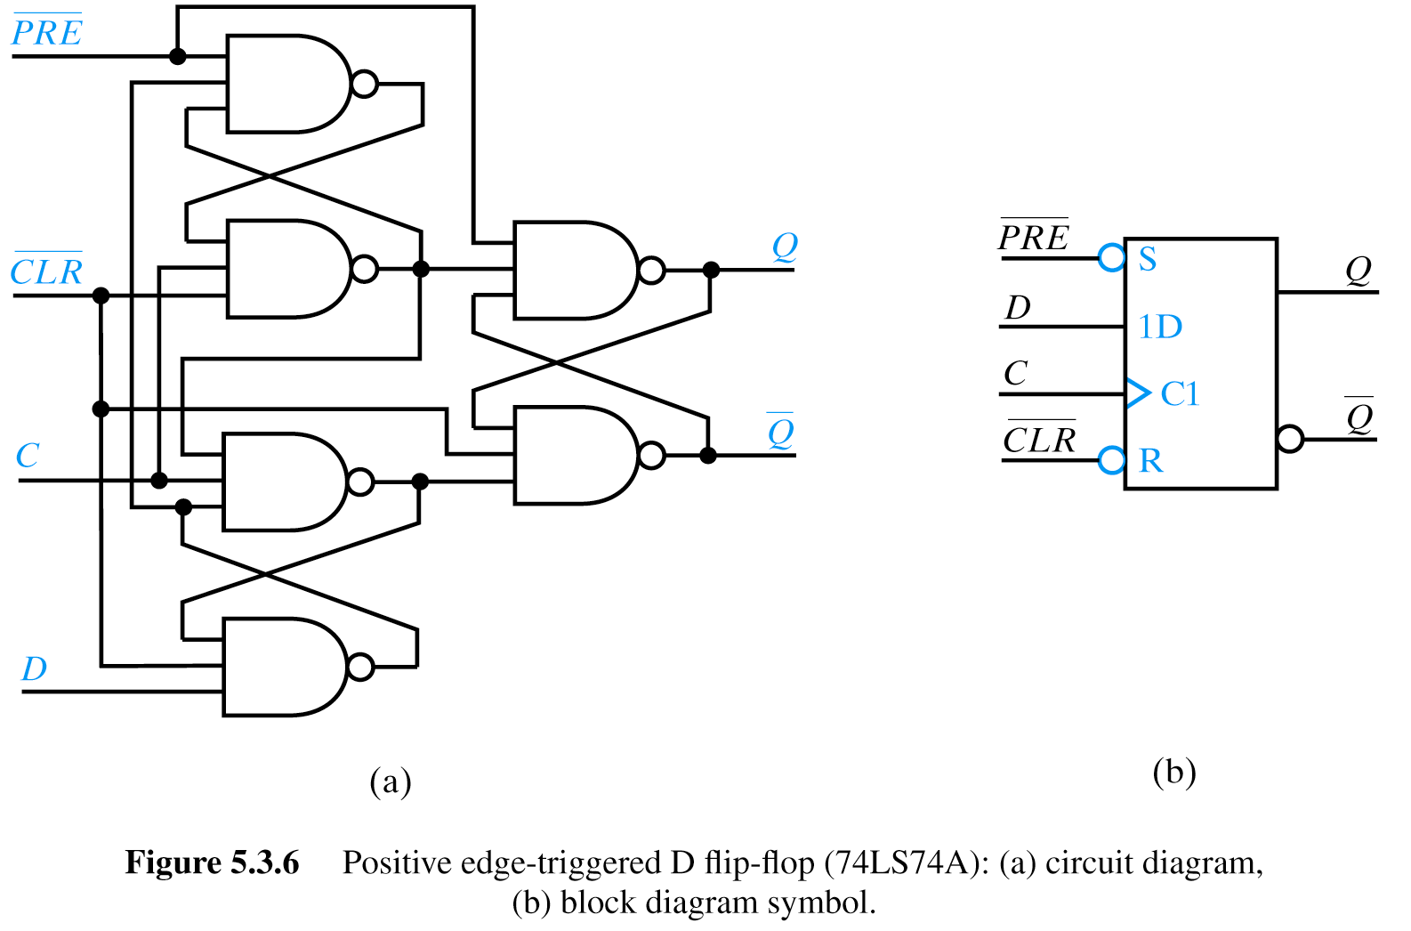
74LS74A

Slide 30
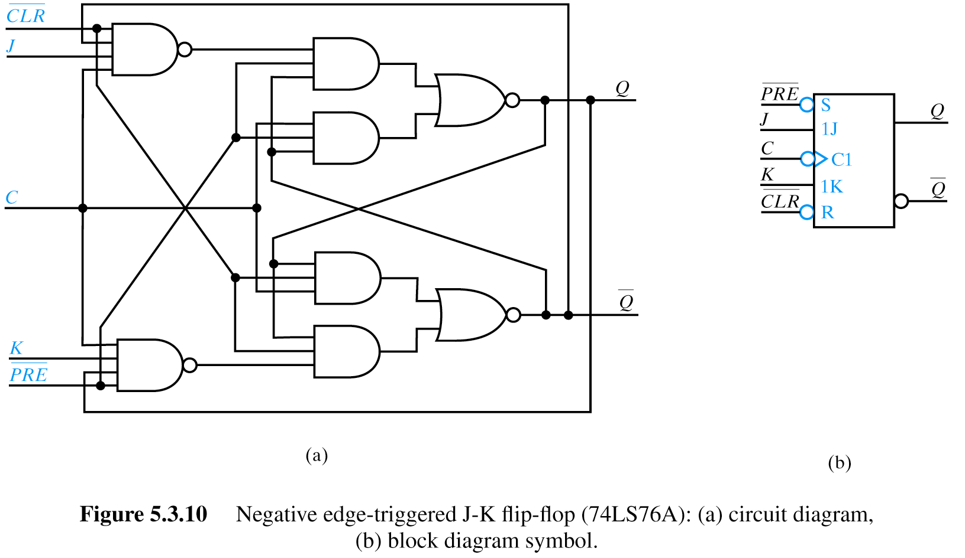
JK Flip Flops
J K Q⁺ Comment
0 0 Q No change
0 1 0 Reset
1 0 1 Set
1 1 Q Toggle

Slide 31
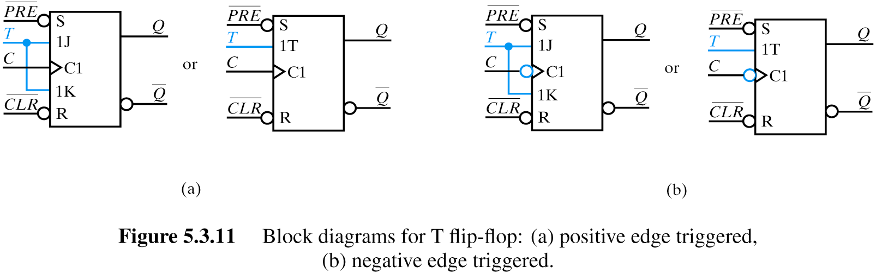
T Flip Flops
J = K=T Q⁺ Comment
0 0 0 Q No change
0 1
1 0
1 1 1 Q Toggle

Slide 32
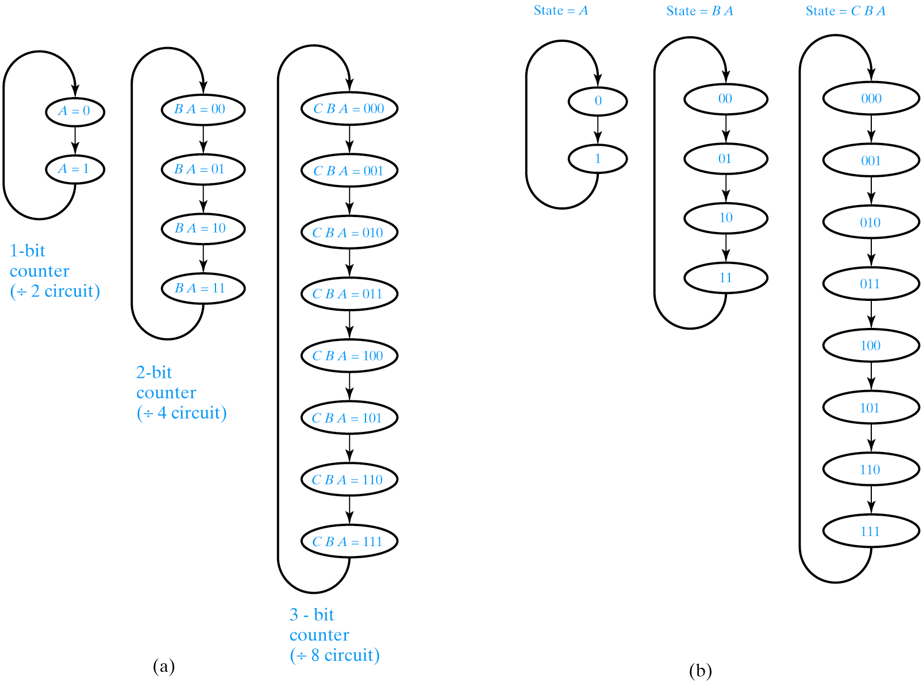
State Diagrams for Binary Up Counters

Slide 33
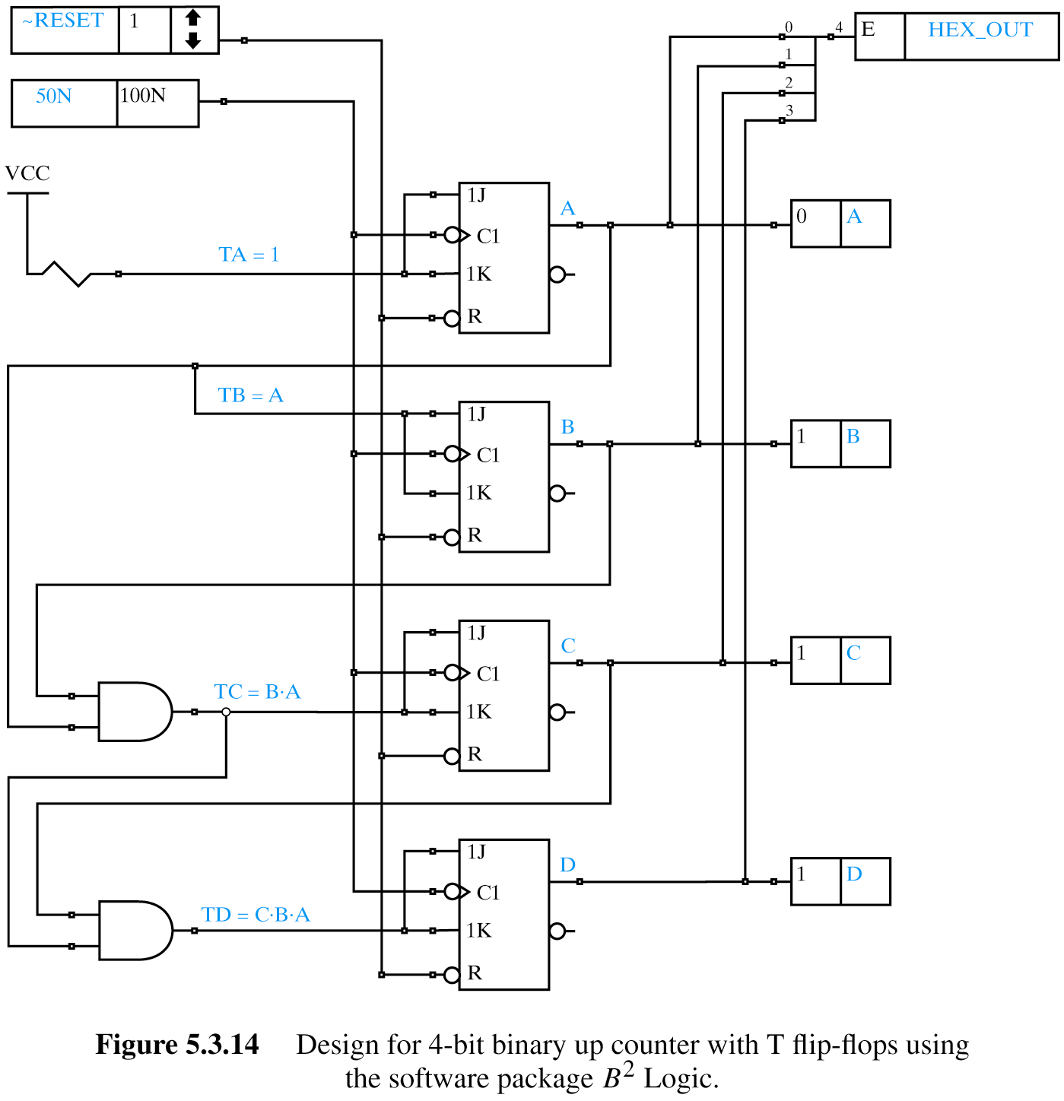
4-Bit Binary Up Counter
T flip flops ideal for counters (remain same or toggle)!

Slide 34
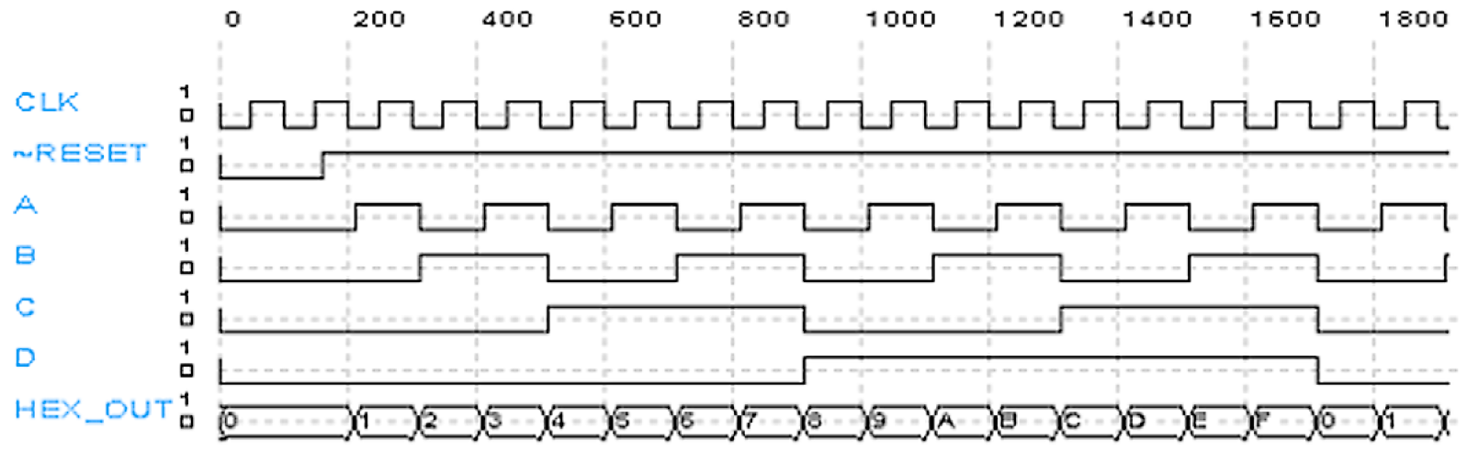
Counter Timing Diagram

Slide 35
State Machines
State Transition Diagrams
Next State Tables
Mealy and Moore Machines
  Mealy: Output logic uses current state and inputs
  Moore: Output logic uses only current state
One Hot vs. Encoded State Machines

Slide 36
Example
T-bird tail-lights

Slide 37
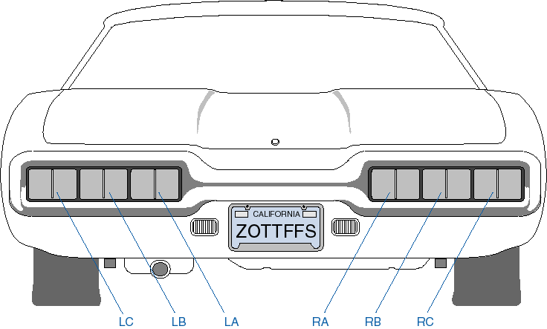
T-bird tail-lights example

Slide 38
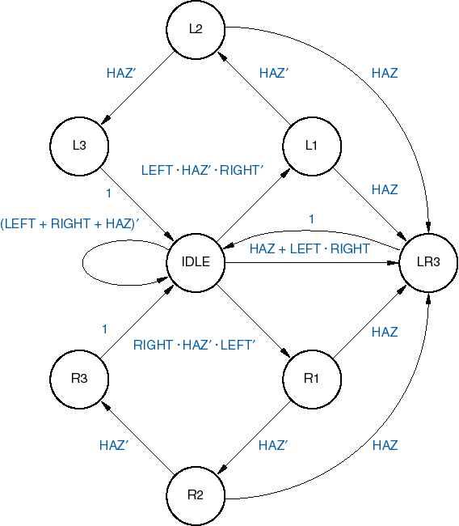
State diagram
Inputs:
LEFT, RIGHT, HAZ
Outputs:
Six lamps
(function of state only)

Slide 39
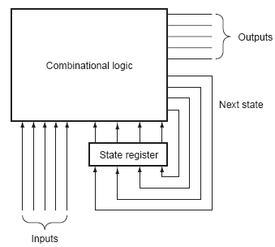
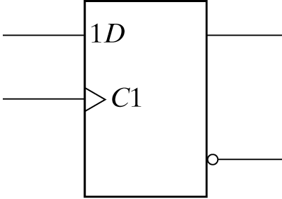
Encoded or One-Hot?
Encoded
  8 states
  2³ = 8
  Need 3 flip flops
  Need to determine state assignment
One-hot
  Dedicate a flip flop per state
  Need 8 flip flops

Slide 40
Implementation
(Encoded, Moore Machine)
Current State
Next
State
Logic
Output
Logic
Inputs
Outputs

Slide 41

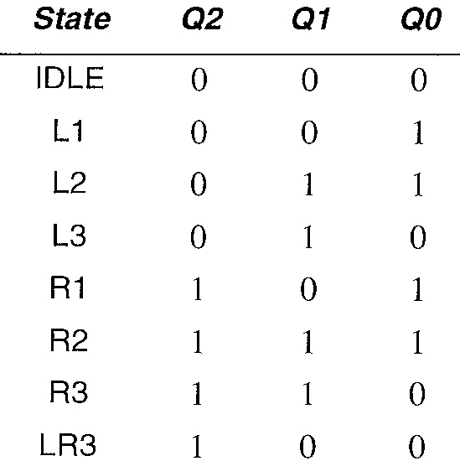
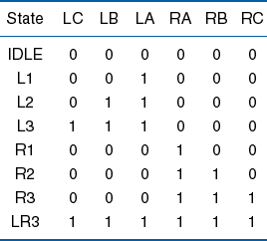
Output logic
Q2
LC = L3 + LR3
LB = L2 + L3 + LR3
LA = L1 + L2 + L3 + LR3
RA = R1 + R2 + R3 + LR3
RB = R2 + R3 + LR3
RC = R3 + LR3
Q1
Q0
LC = Q2’⋅Q1⋅Q0’ + Q2⋅Q1’⋅Q0’
LB = Q2’⋅Q1⋅Q0 + Q2’⋅Q1⋅Q0’ + Q2⋅Q1’⋅Q0’
LA = Q2’⋅Q1’⋅Q0 + Q2’⋅Q1⋅Q0 + Q2’⋅Q1⋅Q0’ + Q2⋅Q1’⋅Q0’
RA = Q2⋅Q1’⋅Q0 + Q2⋅Q1⋅Q0 + Q2⋅Q1⋅Q0’ + Q2⋅Q1’⋅Q0’
RB = Q2⋅Q1⋅Q0 + Q2⋅Q1⋅Q0’ + Q2⋅Q1’⋅Q0’
RC = Q2⋅Q1⋅Q0’ + Q2⋅Q1’⋅Q0’

Slide 42
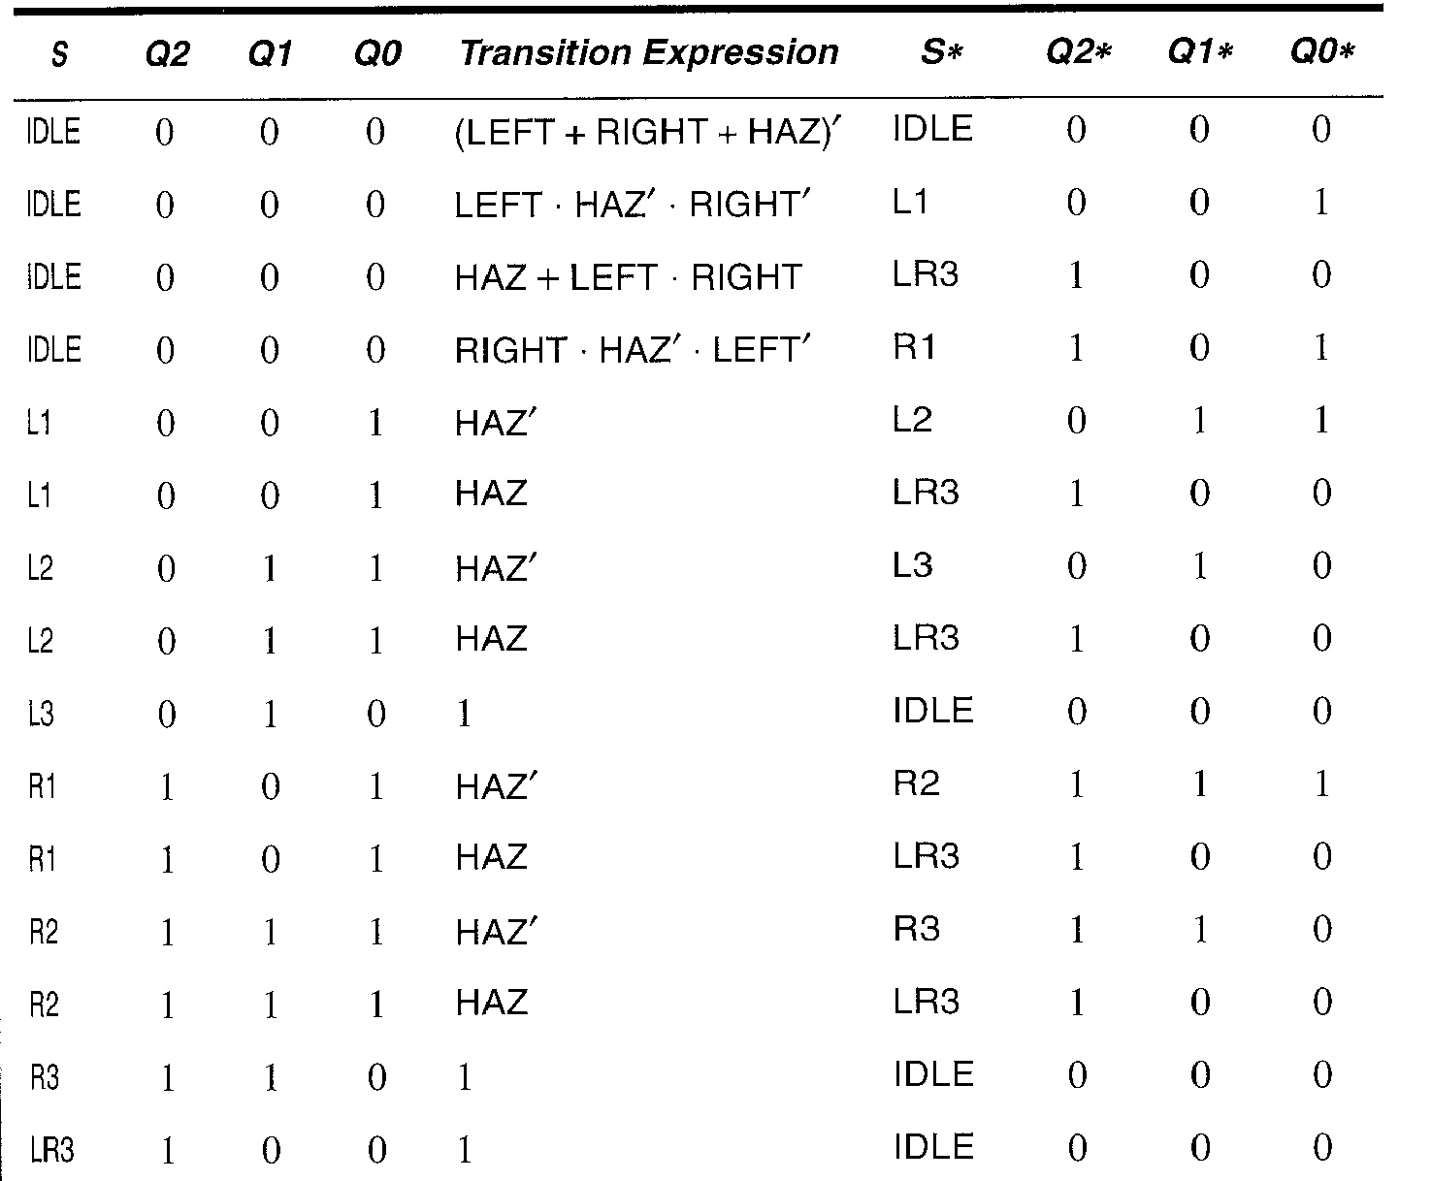
Next State Logic
State transition table for encoded states
Next step depends on implementation choice
  Synthesize or Structural with choice of FFs

Slide 43
Transition Equations
Q2* = Q2’⋅ Q1’ ⋅ Q0’ ⋅ (HAZ + LEFT ⋅ RIGHT)
+ Q2’ ⋅ Q1’ ⋅ Q0’ ⋅ (RIGHT ⋅ HAZ’ ⋅ LEFT’)
+ Q2’ ⋅ Q1’ ⋅ Q0 ⋅ (HAZ)
+ Q2’ ⋅ Q1 ⋅ Q0 ⋅ (HAZ)
+ Q2 ⋅ Q1’ ⋅ Q0 ⋅ (HAZ’)
+ Q2 ⋅ Q1’ ⋅ Q0 ⋅ (HAZ)
+ Q2 ⋅ Q1 ⋅ Q0 ⋅ (HAZ’)
+ Q2 ⋅ Q1 ⋅ Q0 ⋅ (HAZ)
Q2* = Q2’⋅ Q1’ ⋅ Q0’ ⋅ (HAZ + RIGHT)
+ Q2’ ⋅ Q0 ⋅ HAZ
+ Q2 ⋅ Q0

Slide 44
Transition Equations
Q1* = Q2’ ⋅ Q1’ ⋅ Q0 ⋅ (HAZ’)
+ Q2’ ⋅ Q1 ⋅ Q0 ⋅ (HAZ’)
+ Q2 ⋅ Q1’ ⋅ Q0 ⋅ (HAZ’)
+ Q2 ⋅ Q1 ⋅ Q0 ⋅ (HAZ')
Q1* = Q0 ⋅ HAZ’

Slide 45
Transition Equations
No guarantee these are minimal. They certainly aren’t SOP. What we do next depends upon how we’re going to implement the FSM.
Could just give them whole thing to ABEL or some other tool and let it generate minimal SOP.
Also, transition equation isn’t same as excitation equation (unless we’re using D FFs)
Q0* = Q2’ ⋅ Q1’ ⋅ Q0’ ⋅ (LEFT ⋅ HAZ’ ⋅ RIGHT’)
+ Q2’ ⋅ Q1’ ⋅ Q0’ ⋅ (RIGHT ⋅ HAZ’ ⋅ LEFT’)
+ Q2’ ⋅ Q1’ ⋅ Q0 ⋅ (HAZ’)
+ Q2 ⋅ Q1’ ⋅ Q0 ⋅ (HAZ’)
Q0* = Q2’⋅ Q1’ ⋅ Q0’ ⋅ HAZ’ ⋅ (LEFT ⊕ RIGHT)
+ Q1’ ⋅ Q0 ⋅ HAZ’

Slide 46
Implementation
(Encoded, Moore Machine)
Current State
Next
State
Logic
Output
Logic
Inputs
Outputs
What should the clock’s period be?

Slide 47
How Fast Can the Clock Be?
Combinational
Logic
FF 1
FF 2
FF t_{pd}
FF t_{setup}
D1
Q
Combinational t_{pd}
D2
Clock

Slide 48
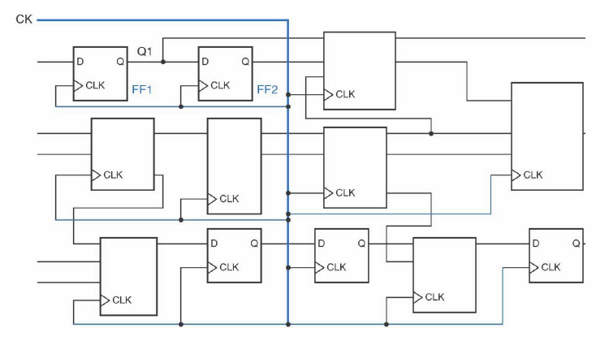
Clock Skew
Even with careful routing, clock will not arrive
at all FFs at the same time. This skew in clock
arrival time affects max clock rate.
Clock Period_{min} = FF t_{pd} + FF t_{setup} + C t_{pd} + t_{skew}
FF t_{pd}
FF t_{setup}
Clock Skew
D1
Q
Combinational t_{pd}
D2
Clock

Slide 49
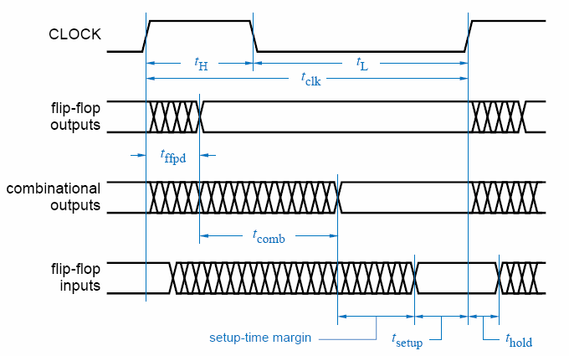

Slide 50

One-Hot
IDLE* = IDLE ⋅ (HAZ + LEFT + RIGHT)’ + L3 + R3 + LR3
L1* = IDLE ⋅ LEFT ⋅ HAZ’ ⋅ RIGHT’
R1* = IDLE ⋅ RIGHT ⋅ HAZ’ ⋅ LEFT’
L2* = L1 ⋅ HAZ’
R2* = R1 ⋅ HAZ’
L3* = L2 ⋅ HAZ’
R3* = R2 ⋅ HAZ’
LR3* = IDLE ⋅ (HAZ + LEFT ⋅ RIGHT) + (L1 + L2 + R1 + R2) ⋅ HAZ
No decoding of state required

Slide 51
Better Still – Behavioral Verilog
parameter
IDLE = 8'b00000001,
L1 = 8'b00000010,
L2 = 8'b00000100,
L3 = 8'b00001000,
R1 = 8'b00010000,
R2 = 8'b00100000,
R3 = 8'b01000000,
LR3 = 8'b10000000;
reg [7:0] State, NextState;
case (State)
IDLE:
begin
if (Hazard || Left && Right)
NextState = LR3;
else if (Left)
NextState = L1;
else if (Right)
NextState = R1;
else
NextState = IDLE;
end
L1: begin
if (Hazard)
NextState = LR3;
else
NextState = L2;
end
L2: begin
if (Hazard)
NextState = LR3;
else
NextState = L3;
end
L3: begin
NextState = IDLE;
end
R1: begin
if (Hazard)
NextState = LR3;
else
NextState = R2;
end
R2: begin
if (Hazard)
NextState = LR3;
else
NextState = R3;
end
R3: begin
NextState = IDLE;
end
LR3:begin
NextState = IDLE;
end
endcase

Slide 52
Example: Traffic Light Controller

Slide 53
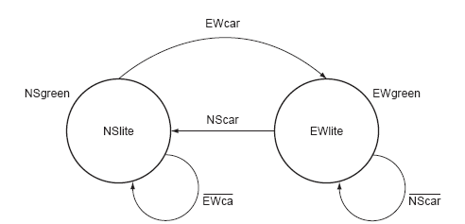
Example: Traffic Light Controller
N
Sensors in road detect approaching car on NS and EW roads, generating input signals NScar and EWcar respectively.
Lights are controlled by outputs NSlite and EWlite.
Traffic lights should change only if there is a car approaching from the other direction. Otherwise the lights should remain unchanged.
W
E
S
NScar
Traffic Light Controller
NSlite
EWlite
EWcar
Clock
r

Slide 54

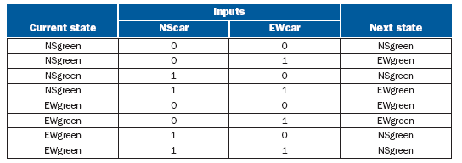

Example: Traffic Light Controller
r
State assignment
NSgreen = 0
EWgreen = 1

Slide 55
Example: Serial Line Code Converter

Slide 56
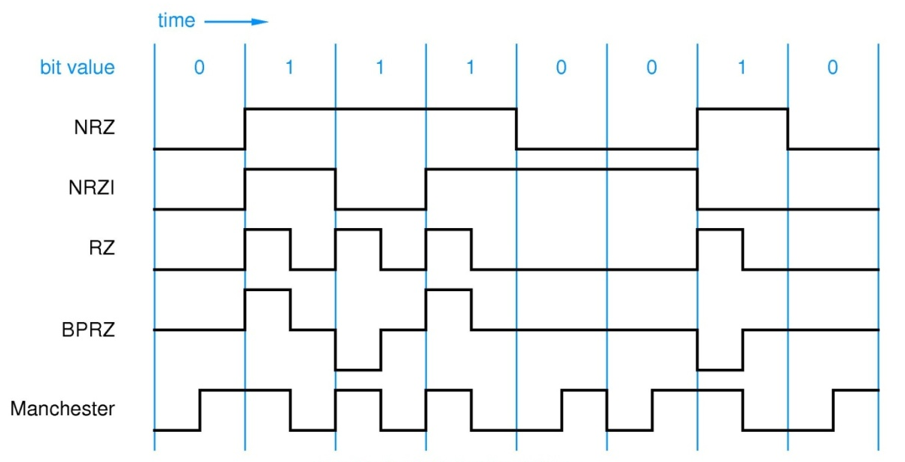
Example: Serial Line Code Converter
BitIn
NRZ to
Manchester
Encoder
BitOut
BitClock
Clock
Clear
S0
0
0
S1
0
1
1
0
0
S3
1
S2
1
1
f_{FSM Clock} = 2 x f_{BitClock}

Slide 57
NRZ to Manchester (Moore FSM)
S0
0
0
S1
0
Rising edge of BitClock coincides with rising edge of FSM clock.
BitIn changes at falling edge of BitClock
Use falling edge of FSM clock for synchronization (will be at midpoint of bit time) so no danger of sampling BitClock while it’s changing
1
1
0
0
S3
1
S2
1
1

Slide 58
//
// Moore FSM for serial line conversion: NRZ to Manchester encoding
//
module NRZtoManchester(Clock, Clear, BitIn, BitOut);
input Clock, Clear, BitIn;
output BitOut;
reg BitOut;
// define states using same names and state assignments as state diagram and table
// Using one-hot method, we have one bit per state
parameter
S0 = 4'b0001,
S1 = 4'b0010,
S2 = 4'b0100,
S3 = 4'b1000;
reg [3:0] State, NextState;
// Update state or reset on every - clock edge
always @(negedge Clock)
begin
if (Clear)
begin
State <= S0;
$display("Reset: S0");
end
else
begin
State <= NextState;
$display("State: %d",State);
end
end
Verilog

Slide 59
// Outputs depend only upon state (Moore machine)
always @(State)
begin
case (State)
S0: BitOut = 1'b0;
S1: BitOut = 1'b0;
S2: BitOut = 1'b1;
S3: BitOut = 1'b1;
endcase
end
// Next state generation logic
always @(State or BitIn)
begin
case (State)
S0: if (BitIn)
NextState = S3;
else
NextState = S1;
S1: if (BitIn)
$display("S1 Error!");
else
NextState = S2;
S2: if (BitIn)
NextState = S3;
else
NextState = S1;
S3: if (BitIn)
NextState = S0;
else
$display("S3 Error!");
endcase
end
endmodule

Slide 60
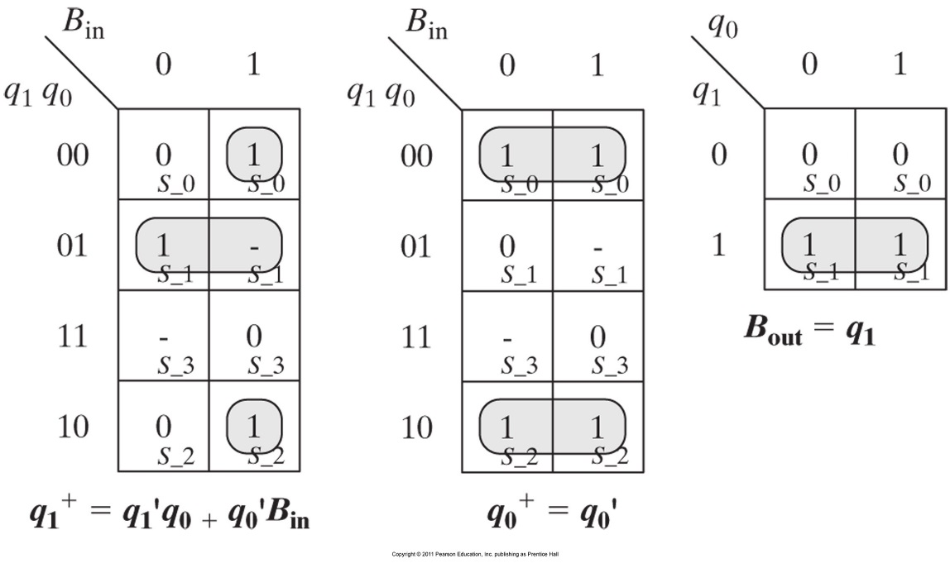
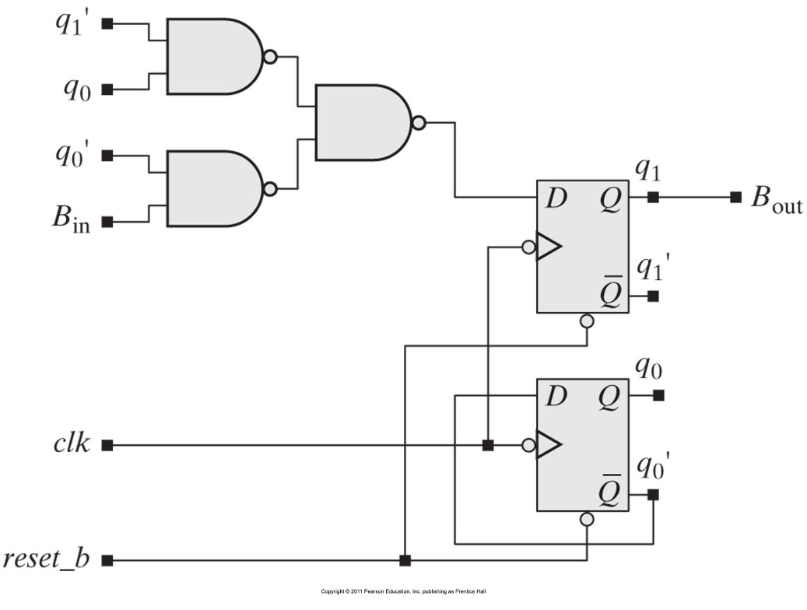

Slide 61
Example:
Airplane Gear

Slide 62
Airplane Gear Example
  PilotLever
  Operated by pilot to control landing gear
  (1:down 0:up)
  PlaneOnGround
  Sensor 1 when plane on ground
  GearIsUp
  Sensor 1 when landing gear fully up
  GearIsDown
  Sensor 1 when landing gear fully down
  TimeUp
  1 when two second timer expired
  Valve
  Controls position of valve (1:lowering 0:raising)
  Pump
  Activates hydraulic pump (1: activate)
  ResetTimer
  1 to reset count-down timer, 0 to count
  RedLED
  Indicates landing gear in motion
  GreenLED
  Indicates landing gear down
PilotLever
Valve
PlaneOnGround
Airplane Landing Gear Control
Pump
GearIsUp
RedLED
GearIsDown
GreenLED
TimeUp
Timer
Do not retract landing gear if plane on ground
Plane should be airborne two seconds before retracting gear

Slide 63
Airplane Landing Gear Example
  Lever
  Operated by pilot to control landing gear
  (0:down 1:up)
  OnGround
  Sensor 1 when plane on ground
  GearUp
  Sensor 1 when landing gear fully up
  GearDown
  Sensor 1 when landing gear fully down
  Valve
  Controls position of valve (0:lowering 1:raising)
  Pump
  Activates hydraulic pump
  RedLED
  Indicates landing gear in motion
  GreenLED
  Indicates landing gear down
Lever
Valve
Airplane Landing Gear Control
OnGround
Pump
GearUp
RedLED
GearDown
GreenLED
Do not retract landing gear if plane on ground
Respond to changes in lever position
(in case plane started with lever in up position)
Plane should be airborne two seconds before retracting gear

Slide 64
State Transition Diagram
~PlaneOnGround
TimeUp && ~PilotLever
Waiting
for
TakeOff
Waiting
for
Timer
Raising
Gear
Gear
Up
Reset
GearIsUp
PlaneOnGround
PilotLever
~PilotLever
PilotLever
~PilotLever
Gear
Down
Lowering
Gear
PlaneOnGround
GearIsDown
State | Reset Timer | Pump | Valve | RedLED | GreenLED
WaitingforTakeoff | 1 | 0 | X | 0 | 1
WaitingforTimer | 0 | 0 | X | 0 | 1
RaisingGear | X | 1 | 0 | 1 | 0
GearUp | X | 0 | X | 0 | 0
LoweringGear | X | 1 | 1 | 1 | 0
GearDown | X | 0 | X | 0 | 1

Slide 65
Example
Vending Machine
Taken from Katz & Borriello, “Contemporary Logic Design”

Slide 66
Example: vending machine
Release item after 15 cents are deposited
Single coin slot for dimes, nickels
No change
Reset
N
Vending
Machine
FSM
Open
Coin
Sensor
Release
Mechanism
D
Clock

Slide 67
Example: vending machine
Suitable abstract representation
  tabulate typical input sequences:
    3 nickels
    nickel, dime
    dime, nickel
    two dimes
  draw state diagram:
    inputs: N, D, reset
    output: open chute
  assumptions:
    assume N and D asserted
    for one cycle
    each state has a self loop
    for N = D = 0 (no coin)
Reset
S0
N
D
S1
S2
N
D
N
D
S3
S4
[open]
S5
[open]
S6
[open]
N
D
S7
[open]
S8
[open]

Slide 68
Example: vending machine
Minimize number of states - reuse states whenever possible
Reset
present inputs next output
state D N state open
0¢ 0 0 0¢ 0
0 1 5¢ 0
1 0 10¢ 0
1 1 – –
5¢ 0 0 5¢ 0
0 1 10¢ 0
1 0 15¢ 0
1 1 – –
10¢ 0 0 10¢ 0
0 1 15¢ 0
1 0 15¢ 0
1 1 – –
15¢ – – 15¢ 1
0¢
N
5¢
D
N
D
10¢
N + D
15¢
[open]
symbolic state table

Slide 69
Example: vending machine
Uniquely encode states
present state inputs next state output
Q1 Q0 D N D1 D0 open
0 0 0 0 0 0 0
0 1 0 1 0
1 0 1 0 0
1 1 – – –
0 1 0 0 0 1 0
0 1 1 0 0
1 0 1 1 0
1 1 – – –
1 0 0 0 1 0 0
0 1 1 1 0
1 0 1 1 0
1 1 – – –
1 1 – – 1 1 1

Slide 70
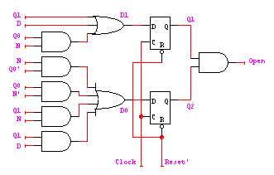
Example: Moore implementation
D1
Q1
D0
Q1
Open
Q1
0 0 1 1
0 1 1 1
X X 1 X
1 1 1 1
0 1 1 0
1 0 1 1
X X 1 X
0 1 1 1
0 0 1 0
0 0 1 0
X X 1 X
0 0 1 0
Mapping to logic
N
N
N
D
D
D
Q0
Q0
Q0
D1 = Q1 + D + Q0 N
D0 = Q0’ N + Q0 N’ + Q1 N + Q1 D
OPEN = Q1 Q0

Slide 71
Example: vending machine
One-hot encoding
present state inputs next state output
Q3 Q2 Q1 Q0 D N D3 D2 D1 D0 open
0 0 0 1 0 0 0 0 0 1 0
0 1 0 0 1 0 0
1 0 0 1 0 0 0
1 1 - - - - -
0 0 1 0 0 0 0 0 1 0 0
0 1 0 1 0 0 0
1 0 1 0 0 0 0
1 1 - - - - -
0 1 0 0 0 0 0 1 0 0 0
0 1 1 0 0 0 0
1 0 1 0 0 0 0
1 1 - - - - -
1 0 0 0 - - 1 0 0 0 1
D0 = Q0 D’ N’
D1 = Q0 N + Q1 D’ N’
D2 = Q0 D + Q1 N + Q2 D’ N’
D3 = Q1 D + Q2 D + Q2 N + Q3
OPEN = Q3

Slide 72
Mealy and Moore state diagrams
Moore machine
  outputs associated with state
Mealy machine
  outputs associated with transitions
Reset
N’ D’ + Reset
Reset/0
(N’ D’ + Reset)/0
0¢
[0]
0¢
N’ D’
N’ D’/0
N
N/0
D
5¢
[0]
D/0
5¢
N’ D’
N’ D’/0
N
N/0
10¢
[0]
10¢
D
N’ D’
D/1
N’ D’/0
N+D
N+D/1
15¢
[1]
15¢
Reset’
Reset’/1

Slide 73
Example: Mealy implementation
Reset/0
Reset/0
present state inputs next state output
Q1 Q0 D N D1 D0 open
0 0 0 0 0 0 0
0 1 0 1 0
1 0 1 0 0
1 1 – – –
0 1 0 0 0 1 0
0 1 1 0 0
1 0 1 1 1
1 1 – – –
1 0 0 0 1 0 0
0 1 1 1 1
1 0 1 1 1
1 1 – – –
1 1 – – 1 1 1
0¢
N’ D’/0
N/0
D/0
5¢
N’ D’/0
N/0
10¢
D/1
N’ D’/0
N+D/1
15¢
Q1
Reset’/1
Open
0 0 1 0
0 0 1 1
X X 1 X
0 1 1 1
D0 = Q0’N + Q0N’ + Q1N + Q1D
D1 = Q1 + D + Q0N
OPEN = Q1Q0 + Q1N + Q1D + Q0D
N
D
Q0

Slide 74
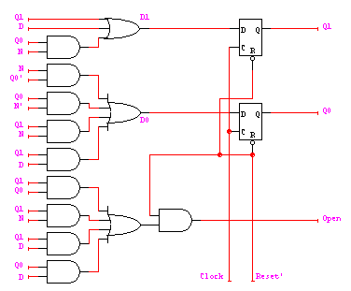
Example: Mealy implementation
D0 = Q0’N + Q0N’ + Q1N + Q1D
D1 = Q1 + D + Q0N
OPEN = Q1Q0 + Q1N + Q1D + Q0D
make sure OPEN is 0 when reset
– by adding AND gate

Slide 75
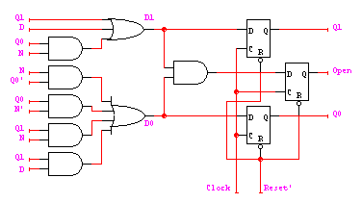
Moore to synchronous Mealy
OPEN = Q1Q0 creates a combinational delay after Q1 and Q0 change in Moore implementation
This can be corrected by retiming, i.e., move flip-flops and logic through each other to improve delay
OPEN.d = (Q1 + D + Q0N)(Q0'N + Q0N' + Q1N + Q1D)
= Q1Q0N' + Q1N + Q1D + Q0'ND + Q0N'D
Implementation now looks like a synchronous Mealy machine
  it is common for programmable devices to have FF at end of logic

Slide 76
Mealy to synchronous Mealy
OPEN.d = Q1Q0 + Q1N + Q1D + Q0D
OPEN.d = (Q1 + D + Q0N)(Q0'N + Q0N' + Q1N + Q1D)
= Q1Q0N' + Q1N + Q1D + Q0'ND + Q0N'D
Open.d
Q1
Open.d
Q1
0 0 1 0
0 0 1 1
1 0 1 1
0 1 1 1
0 0 1 0
0 0 1 1
X X 1 X
0 1 1 1
N
N
D
D
Q0
Q0

Slide 77
Types of FSMs
inputs
combinational
logic for
next state
Moore
logic for
outputs
reg
outputs
state feedback
inputs
logic for
outputs
outputs
Mealy
combinational
logic for
next state
reg
state feedback
inputs
logic for
outputs
outputs
Synchronous Mealy
combinational
logic for
next state
reg
state feedback

Slide 78
Sources
Prof. Mark G. Faust
John Wakerly

